Slide 1
Chapter 12: Query Processing

Slide 2
Chapter 12: Query Processing
Overview
Measures of Query Cost
Selection Operation
Sorting
Join Operation
Other Operations
Evaluation of Expressions

Slide 3
Basic Steps in Query Processing
1. Parsing and translation
2. Optimization
3. Evaluation

Slide 4
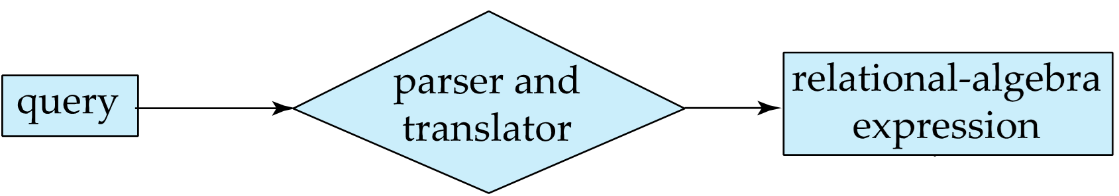
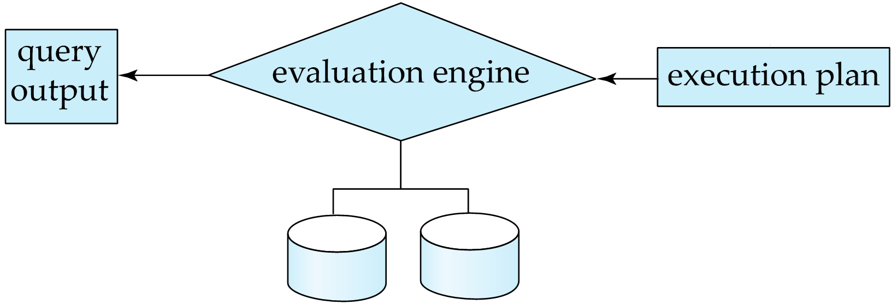
Basic Steps in Query Processing (Cont.)
Parsing and translation
translate the query into its internal form. This is then translated into relational algebra.
Parser checks syntax, verifies relations
Evaluation
The query-execution engine takes a query-evaluation plan, executes that plan, and returns the answers to the query.
Data dictionary

Slide 5
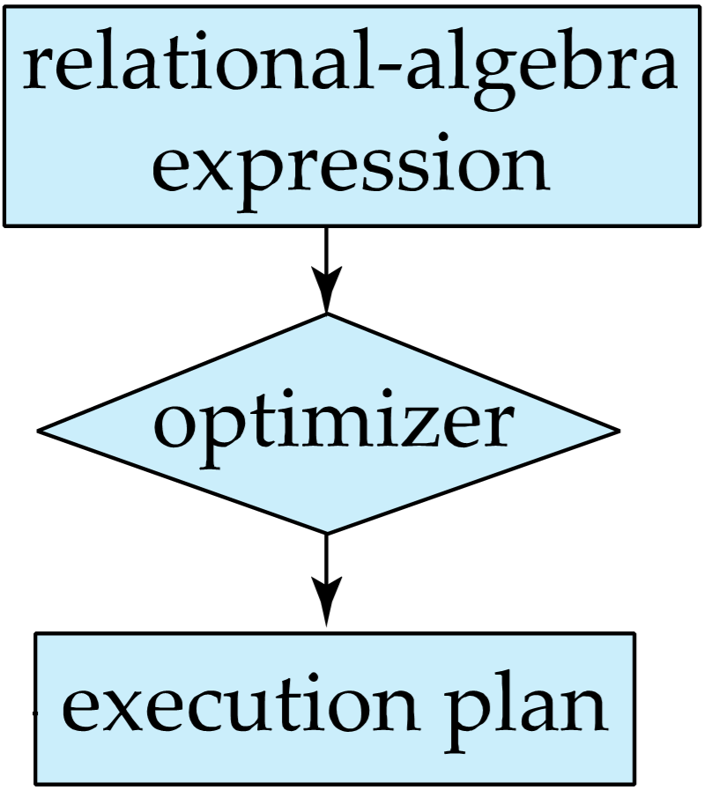
Basic Steps in Query Processing : Optimization
A relational algebra expression may have many equivalent expressions
E.g., σ_{salary<75000}(∏_{salary}(instructor)) ∏_{salary}(σ_{salary<75000}(instructor))
Each relational algebra operation can be evaluated using one of several different algorithms
Correspondingly, a relational-algebra expression can be evaluated in many ways.

Slide 6
Basic Steps in Query Processing : Optimization
Annotated expression specifying detailed evaluation strategy is called an evaluation-plan.
E.g., can use an index on salary to find instructors with salary < 75000,
or can perform complete relation scan and discard instructors with salary ≥ 75000

Slide 7
Basic Steps: Optimization (Cont.)
Query Optimization: Amongst all equivalent evaluation plans choose the one with lowest cost.
Cost is estimated using statistical information from the database catalog
e.g. number of tuples in each relation, size of tuples, etc.
In this chapter we study
How to measure query costs
Algorithms for evaluating relational algebra operations
How to combine algorithms for individual operations in order to evaluate a complete expression
In Chapter 14
We study how to optimize queries, that is, how to find an evaluation plan with lowest estimated cost

Slide 8
Example
Schema
branch (branch_name, branch_city, assets)
account (account_number, branch_name, balance)
depositor (customer_name, account_number)
Query: Find the names of all customers with an account at a Brooklyn branch whose account balance is less than $1000.

Slide 9
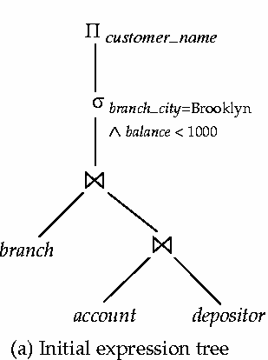
Example（语法分析与翻译）
SQL:
SELECT customer_name FROM account, branch, depositor WHERE branch_city = “Brooklyn” and balance < 1000 and account.customer_name=depositor.customer_name and branch.branch_name = account.branch_name
Π_{customer_name}((σbranch_city = “Brooklyn” ∧ balance < 1000 (branch (account depositor)))

Slide 10
Example（查询优化）
Query: Find the names of all customers with an account at a Brooklyn branch whose account balance is less than $1000. Π_{customer_name}((σbranch_city = “Brooklyn” ∧ balance < 1000 (branch (account depositor)))
优化策略1： branch的记录数不会太多，根据自然连接运算的结合律: Π_{customer_name}((σbranch_city = “Brooklyn” ∧ balance < 1000 (branch account)) depositor)
优化策略2： 及早进行“选择σ”操作，可减少中间结果 σ_{branch_city = “Brooklyn”} (branch) σ _{balance < 1000} (account)

Slide 11
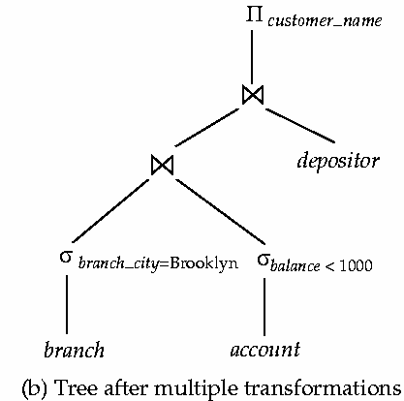
Example（优化结果）
Π_{customer_name}( (
σ_{branch_city = “Brooklyn”} (branch) σ _{balance < 1000} (account) ) depositor)

Slide 12
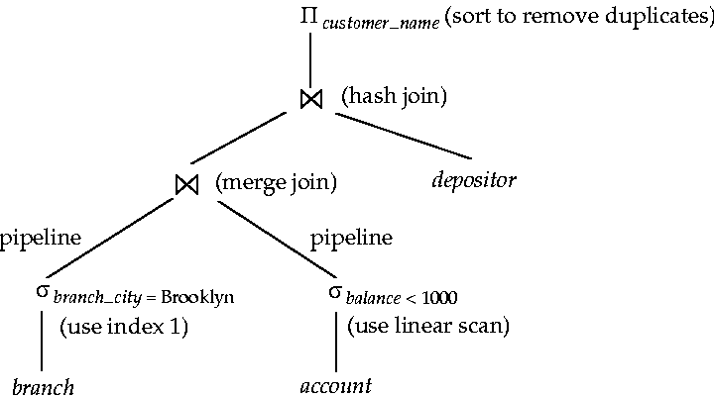
Example（执行计划）
Query: Find the names of all customers with an account at a Brooklyn branch whose account balance is less than $1000.

Slide 13
Measures of Query Cost
Cost is generally measured as total elapsed time for answering query
Many factors contribute to time cost
disk accesses, CPU, or even network communication
Typically disk access is the predominant cost, and is also relatively easy to estimate. Measured by taking into account
Number of seeks * average-seek-cost
Number of blocks read * average-block-read-cost
Number of blocks written * average-block-write-cost
Cost to write a block is greater than cost to read a block
data is read back after being written to ensure that the write was successful

Slide 14
Measures of Query Cost (Cont.)
For simplicity we just use the number of block transfers from disk and the number of seeks as the cost measures
t_{T} – time to transfer one block
t_{S} – time for one seek
Cost for b block transfers plus S seeks b * t_{T} + S * t_{S}
We ignore CPU costs for simplicity
Real systems do take CPU cost into account
We do not include cost to writing output to disk in our cost formulae

Slide 15
Measures of Query Cost (Cont.)
Several algorithms can reduce disk IO by using extra buffer space
Amount of real memory available to buffer depends on other concurrent queries and OS processes, known only during execution
We often use worst case estimates, assuming only the minimum amount of memory needed for the operation is available
Required data may be buffer resident already, avoiding disk I/O
But hard to take into account for cost estimation
Notes:
15

Slide 16
Selection Operation

Slide 17
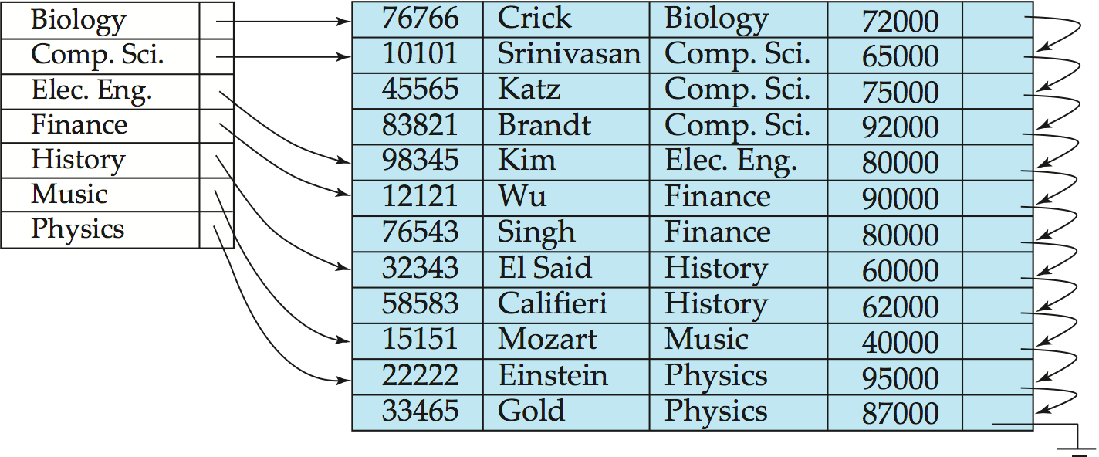
Primary Index ^{(REVIEW)}
Primary index: Index entries are sorted in the same way as the database records.

Slide 18
Secondary Index ^{(REVIEW)}
Secondary index: Index entries are sorted in a way different from the database records.
Re-directional pointers

Slide 19
Selection Operation
File scan
Algorithm A1 (linear search). Scan each file block and test all records to see whether they satisfy the selection condition.
Cost estimate = b_{r} block transfers + 1 seek
b_{r} denotes number of blocks containing records from relation r
If selection is on a key attribute, can stop on finding record
cost = (b_{r} /2) block transfers + 1 seek
Linear search can be applied regardless of
selection condition or
ordering of records in the file, or
availability of indices
Note: binary search generally does not make sense since data is not stored consecutively
except when there is an index available,
and binary search requires more seeks than index search

Slide 20
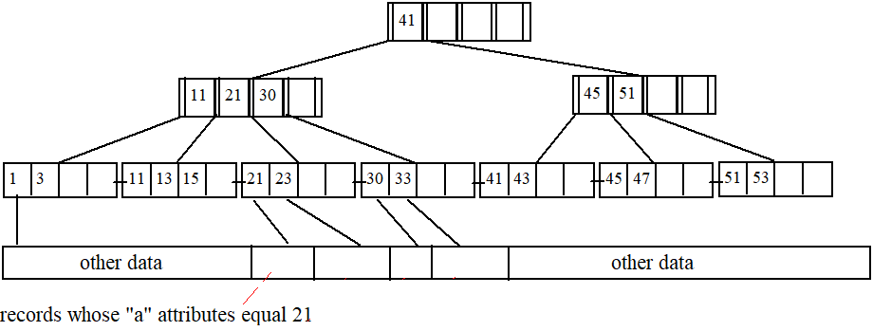
Selections Using Indices
Index scan – search algorithms that use an index
selection condition must be on search-key of index.
A2 (primary index, equality on key). Retrieve a single record that satisfies the corresponding equality condition
Select … from T where T.a = 21
Cost = (h_{i} + 1) * (t_{S} + t_{T})

Slide 21
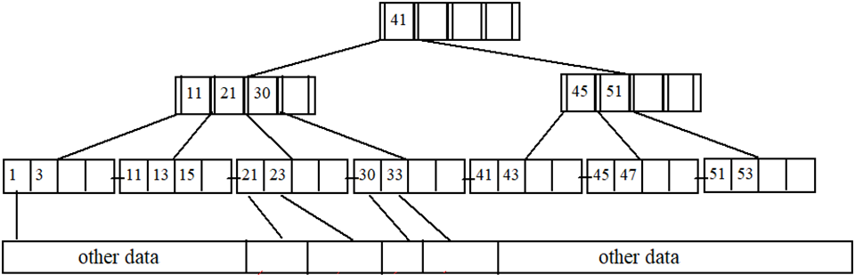
Selections Using Indices
A3 (primary index, equality on nonkey) Retrieve multiple records.
Records will be on consecutive blocks
Let b = number of blocks containing matching records
Cost = h_{i} * (t_{T} + t_{S}) + t_{S} + t_{T} * b
Select … from T where T.c = 21

Slide 22
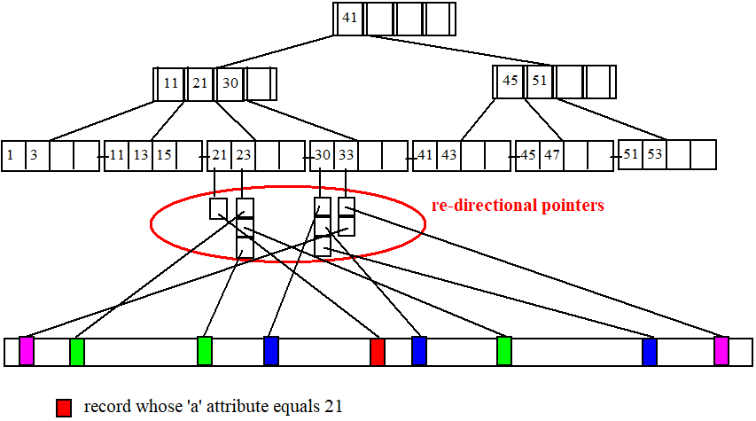
Selections Using Indices
A4 (secondary index, equality on nonkey).
Retrieve a single record if the search-key is a candidate key
Cost = (h_{i} + 1) * (t_{T} + t_{S})
Select … from T where T.a = 21
Notes:
22

Slide 23
Selections Using Indices
A4 (secondary index, equality on nonkey).
Retrieve multiple records if search-key is not a candidate key
each of n matching records may be on a different block
Select … from T where T.a = 23
Cost = (h_{i} + n) * (t_{T} + t_{S})
Can be very expensive!
Notes:
23

Slide 24
Selections Involving Comparisons
Can implement selections of the form σ_{A≤V} (r) or σ_{A ≥ V}(r) by using
a linear file scan,
or by using indices in the following ways:
A5 (primary index, comparison). (Relation is sorted on A)
For σ_{A ≥ V}(r) use index to find first tuple ≥ v and scan relation sequentially from there
For σ_{A≤V} (r) just scan relation sequentially till first tuple > v; do not use index
Select … from T where T.a >= 21 and T.a <= 30
Cost = h_{i} * (t_{T} + t_{S}) + t_{S} + t_{T} * b

Slide 25
Selections Involving Comparisons
A6 (secondary index, comparison).
For σ_{A ≥ V}(r) use index to find first index entry ≥ v and scan index sequentially from there, to find pointers to records.
For σ_{A≤V} (r) just scan leaf pages of index finding pointers to records, till first entry > v
In either case, retrieve records that are pointed to
requires an I/O for each record
Linear file scan may be cheaper
Select … from T where T.a >= 21 and T.a <= 30
Cost = (h_{i} + n) * (t_{T} + t_{S})

Slide 26
Implementation of Complex Selections
Conjunction: σ_{θ1}∧ _{θ2}∧. . . _{θn}(r)
A7 (conjunctive selection using one index).
Select a combination of θ_{i} and algorithms A1 through A7 that results in the least cost for σ_{θi} (r).
Test other conditions on tuple after fetching it into memory buffer.
A8 (conjunctive selection using composite index).
Use appropriate composite (multiple-key) index if available.
A9 (conjunctive selection by intersection of identifiers).
Requires indices with record pointers.
Use corresponding index for each condition, and take intersection of all the obtained sets of record pointers.
Then fetch records from file
If some conditions do not have appropriate indices, apply test in memory.

Slide 27
Select-多字段查询:A9
考虑以下查询：
Select … from T where T.a >= 21 and T.a <= 30 and T.b >= 21 and T.b <= 30.
Case 1: 字段 ‘a’和 ‘b’上都没有建立索引，则：
只能使用顺序扫描
Case 2:字段 ‘a’上有索引，而 ‘b’上没有索引，则：
找出那些满足 21 <= T.a and T.a <= 30的记录
去除那些不满足 21 <= T.b and T.b <= 30的记录
Cost ?
与a上的单字段查询代价一样，因为记录已经被读入内存
Case 3:字段 ‘b’上有索引，而 ‘a’上没有索引’
情况类似.

Slide 28
Select-多字段查询:A9
Case 4: 如果字段T.a和T.b上都建立了索引，那么执行计划又将不同
考虑以下查询：
Select … from T where T.a >= 21 and T.a <= 30 and T.b >= 21 and T.b <= 30.

Slide 29
Select-多字段查询:A9
First, using the B-tree on ‘a’, we retrieve the set S₁ of re-directional pointers of the leaf entries in [21, 30].
S₁

Slide 30
Select-多字段查询:A9
Then, from the B-tree on ‘b’, we retrieve the set S₂ of re-directional pointers of the leaf entries in [21, 30].
S₂

Slide 31
Select-多字段查询:A9
Compute S₁ ∩ S₂, which leads to a single disk address 7.
That is, only 1 tuple satisfies the query.
Visit page 7 to retrieve the tuple.
S₁∩S₂

Slide 32
Algorithms for Complex Selections
Disjunction:σ_{θ1}∨ _{θ2} ∨. . . _{θn} (r).
A10 (disjunctive selection by union of identifiers).
Applicable if all conditions have available indices.
Otherwise use linear scan.
Use corresponding index for each condition, and take union of all the obtained sets of record pointers.
Then fetch records from file
Negation: σ_{¬θ}(r)
Use linear scan on file
If very few records satisfy ¬θ, and an index is applicable to θ
Find satisfying records using index and fetch from file

Slide 33
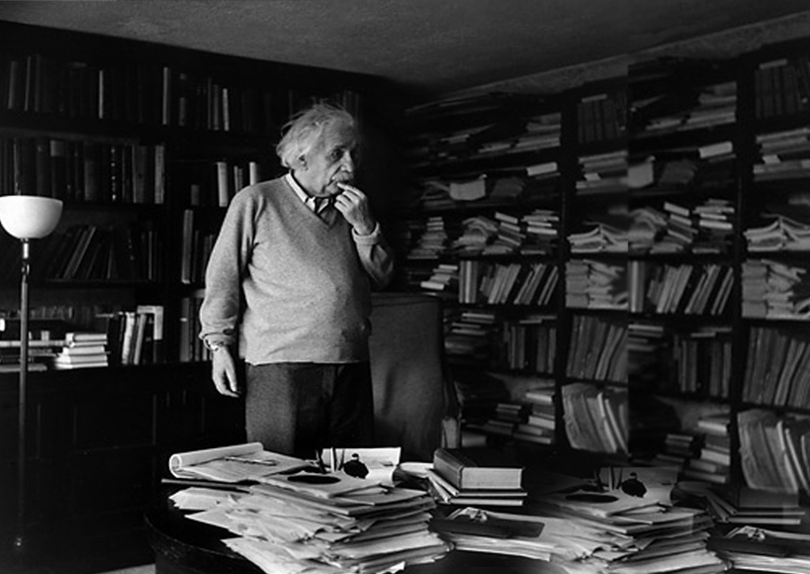
Sorting
Where is it ？
SORTING IS NEEDED IN LIFE.

Slide 34
Sorting
Sorting of data plays an important role in database systems
SQL queries can specify: order by, distinct, group by……
query processing (such as join) can be implemented efficiently if the input relations are first sorted.
We may build an index on the relation, and then use the index to read the relation in sorted order. May lead to one disk block access for each tuple.
For relations that fit in memory, techniques like quicksort can be used. For relations that don’t fit in memory, external sort-merge is a good choice.

Slide 35
External Sort-Merge
Let M denote memory size (in pages).
Create sorted runs. Let i be 0 initially. Repeatedly do the following till the end of the relation: (a) Read M blocks of relation into memory (b) Sort the in-memory blocks (c) Write sorted data to run R_{i}; increment i. Let the final value of i be N
Merge the runs (next slide)…..

Slide 36
External Sort-Merge (Cont.)
Merge the runs (N-way merge). We assume (for now) that N < M.
Use N blocks of memory to buffer input runs, and 1 block to buffer output. Read the first block of each run into its buffer page
repeat
Select the first record (in sort order) among all buffer pages
Write the record to the output buffer. If the output buffer is full write it to disk.
Delete the record from its input buffer page. If the buffer page becomes empty then read the next block (if any) of the run into the buffer.
until all input buffer pages are empty:

Slide 37
External Sort-Merge (Cont.)
If N ≥ M, several merge passes are required.
In each pass, contiguous groups of M - 1 runs are merged.
A pass reduces the number of runs by a factor of M -1, and creates runs longer by the same factor.
E.g. If M=11, and there are 90 runs, one pass reduces the number of runs to 9, each 10 times the size of the initial runs
Repeated passes are performed till all runs have been merged into one.

Slide 38
外排序(例子一)
假设每个磁盘页可以容纳2个记录
内存最多可以放下3个磁盘页
目的：将以下记录按升序排列并要求I/O尽可能的小
外排序一般包含两个步骤：
Preliminary Sorting （预排序）
Merging （归并）

Slide 39
预排序(例子)
第一个有序归并段
I/O Cost = 6 page accesses
3 reads + 3 writes.

Slide 40
预排序(例子)
第二个有序归并段
I/O Cost = 6 page accesses
3 reads + 3 writes.

Slide 41
预排序(例子)
Do the same for every 3 subsequent pages.
预排序结束后，一共得到4个有序归并段
总I/O代价 = 24 page accesses (12 reads + 12 writes). = twice the relation size.

Slide 42
1st 归并(例子)
该步骤的目标如下：

Slide 43
1st 归并(例子)
我们先来看看runs 0-1和runs 0-2是如何被归并为runs 1-1的.

Slide 44
归并两个有序归并段(例子)

Slide 45
归并两个有序归并段(例子)

Slide 46
归并两个有序归并段(例子)

Slide 47
归并两个有序归并段(例子)

Slide 48
归并两个有序归并段(例子)

Slide 49
归并两个有序归并段(例子)

Slide 50
归并两个有序归并段(例子)

Slide 51
1st 归并(代价)
再将runs 0-3和runs 0-4归并为runs 1-2.
1st 归并过程的I/O代价= 24 I/O accesses.
12 reads and 12 writes.（每页都是读一次，写一次）
该步骤完成之后，只剩下2个有序归并段runs 1-1和runs 1-2

Slide 52
2nd 归并过程(例子)
依照前面的排序方法，我们把runs 1-1和runs 1-2进行归并
Cost of the 2nd merging = 24 I/O accesses.
12 reads and 12 writes.
该步骤完成之后，只剩下1个有序归并段– 排序完成!

Slide 53
归并排序总I/O代价
Preliminary sorting step => 24 I/Os
1st merging step => 24 I/Os
2nd merging => 24 I/Os
Total 72 I/Os.

Slide 54
外排序例子二
Sort a file with 108 pages, using only 5 memory pages.
Total cost = 216 x 4 = 864 I/O accesses

Slide 55
一般情况下的外排序（M-路归并）
Sort a file with b_{r} pages, using M memory pages.
The preliminary sorting step produces n₀ = ⎡ b_{r} / M⎤ sorted runs by performing 2b_{r} I/Os.
The 1st merging step produces n₁ = ⎡n₀ / (M – 1)⎤ runs with 2b_{r} I/Os.
The 2nd merging step produces n₂ = ⎡n₁ / (M – 1)⎤ runs with 2b_{r} I/Os.
…
The last merging step produces n_{x} = ⎡n_{x-1} / (M – 1)⎤ = 1 run with 2b_{r} I/Os.

Slide 56
一般情况下的外排序I/O代价估计
Therefore the total cost =2b_{r} + 2b_{r} ⋅ x I/Os,
where x is the number of merging steps.
How to compute x?
Start with y = n₀
Do y = ⎡y / (M – 1)⎤ repetitively.
x is the number of repetitions before y becomes 1.
x =┌log_{M-1}(b_{r} /M)┐
Total I/O cost：2b_{r} + 2b_{r} ⋅ ┌log_{M-1}(b_{r} /M)┐

Slide 57
External Merge Sort (Cont.)
Cost analysis:
Total number of merge passes required: ⎡log_{M–1}(b_{r}/M)⎤.
Block transfers for initial run creation as well as in each pass is 2b_{r}
for final pass, we don’t count write cost
we ignore final write cost for all operations since the output of an operation may be sent to the parent operation without being written to disk
Thus total number of block transfers for external sorting: b_{r} ( 2 ⎡log_{M–1}(b_{r} / M)⎤ + 1)
Seeks: next slide

Slide 58
External Merge Sort (Cont.)
Cost of seeks
During run generation: one seek to read each run and one seek to write each run
2 ⎡b_{r} / M⎤
During the merge phase
Buffer size: b_{b} (read/write b_{b} blocks at a time)
Need 2 ⎡b_{r} / b_{b}⎤ seeks for each merge pass
except the final one which does not require a write
Total number of seeks: 2 ⎡b_{r} / M⎤ + ⎡b_{r} / b_{b}⎤ (2 ⎡log_{M–1}(b_{r} / M)⎤ -1)

Slide 59
Join Operation

Slide 60
Join Operation
Several different algorithms to implement joins
Nested-loop join
Block nested-loop join
Indexed nested-loop join
Merge-join
Hash-join
Choice based on cost estimate
Examples use the following information
Number of records of student: 5,000 takes: 10,000
Number of blocks of student: 100 takes: 400

Slide 61
Nested-Loop Join
To compute the theta join r _{θ} s for each tuple t_{r} in r do begin for each tuple t_{s} in s do begin test pair (t_{r},t_{s}) to see if they satisfy the join condition θ if they do, add t_{r} • t_{s} to the result. end end
r is called the outer relation and s the inner relation of the join.
Requires no indices and can be used with any kind of join condition.
Expensive since it examines every pair of tuples in the two relations.

Slide 62
Nested-Loop Join
特点：以元组（记录）为单位进行操作
关系大小：R -- n_{r} , b_{r}，S -- n_{s} , b_{s}

Slide 63
Nested-Loop Join (Cont.)
In the worst case, if there is enough memory only to hold one block of each relation, the estimated cost is n_{r} ∗ b_{s} + b_{r} block transfers, plus n_{r} + b_{r} seeks
If the smaller relation fits entirely in memory, use that as the inner relation.
Reduces cost to b_{r} + b_{s} block transfers and 2 seeks

Slide 64
Nested-Loop Join (Cont.)
Assuming worst case memory availability cost estimate is
with student as outer relation:
5000 ∗ 400 + 100 = 2,000,100 block transfers,
5000 + 100 = 5100 seeks
with takes as the outer relation
10000 ∗ 100 + 400 = 1,000,400 block transfers and 10,400 seeks
If smaller relation (student) fits entirely in memory, the cost estimate will be 500 block transfers.
Block nested-loops algorithm (next slide) is preferable.

Slide 65
Block Nested-Loop Join
磁盘←→内存：以物理块（block）为信息传递的单位，面向block的连接称为块嵌套循环连接（BNL）
for each block B_{R} of R do begin for each block B_{S} of S do begin for each tuple t_{R} in B_{R} do begin for each tuple t_{S} in B_{S} do begin Check if (t_{R},t_{S}) satisfy the join condition if they do, add t_{R} • t_{S} to the result. end end end
end
ACCOUNT
CUSTOMER
name
account id
customer id
balance
customer id
1
John
A1
1
20k
Smith
A2
1
5k
2
A3
2
35k
3
Joan
A4
3
100k

Slide 66
Block Nested-Loop Join
R
S
Two tables R and S, with b_{r} and b_{s} pages respectively.
Memory has M pages.
How to compute the Cartesian product of R and S?
. . .
. . .
b_{r}
b_{s}
. . .
. . .
. . .

Slide 67
Block Nested-Loop Join
R
M_{th}
S
Without loss of generality, assume b_{r} < b_{s}.
Load the first M - 1 pages of R into memory.
Perform one scan on S using the last available memory page.
M-1
. . .
. . .
b_{r}
b_{s}
. . .
. . .
. . .

Slide 68
Block Nested-Loop Join
R
M_{th}
S
Load the next M - 1 pages of T₁ into memory.
Perform one scan on T₂.
…
Until all pages in T₁ are loaded once.
I/O Cost?
M-1
. . .
M-1
. . .
b_{r}
b_{s}
. . .
. . .
M-1
. . .
⎡b_{r} / (M - 1)⎤ ⋅ b_{s} + b_{r}

Slide 69
Block Nested-Loop Join (Cont.)
R
S
Discuss：
Worst case estimate:
b_{r} ∗ b_{s} + b_{r} block transfers
2 * b_{r} seeks
Best case:
b_{r} + b_{s} block transfers
2 seeks.
. . .
⎡b_{r} / (M - 1)⎤ ⋅ b_{s} + b_{r}
. . .
b_{r}
b_{s}
. . .
. . .
. . .

Slide 70
Block Nested-Loop Join (Cont.)
Improvements to nested loop and block nested loop algorithms:
In block nested-loop, use M - 2 disk blocks as blocking unit for outer relations, where M = memory size in blocks; use remaining two blocks to buffer inner relation and output
Cost = ⎡b_{r} / (M-2)⎤ ∗ b_{s} + b_{r} block transfers
+ 2 ⎡b_{r} / (M-2)⎤ seeks
If equi-join attribute forms a key or inner relation, stop inner loop on first match
Scan inner loop forward and backward alternately, to make use of the blocks remaining in buffer (with LRU replacement)
Use index on inner relation if available (next slide)

Slide 71
Indexed Nested-Loop Join
Index lookups can replace file scans if
join is an equi-join or natural join and
an index is available on the inner relation’s join attribute
Can construct an index just to compute a join.
For each tuple t_{r} in the outer relation r, use the index to look up tuples in s that satisfy the join condition with tuple t_{r}.
r
s
s

Slide 72
Indexed Nested-Loop Join
Worst case: buffer has space for only one page of r, and, for each tuple in r, we perform an index lookup on s.
Cost of the join: b_{r} (t_{T} + t_{S}) + n_{r} ∗ c
Where c is the cost of traversing index and fetching all matching s tuples for one tuple or r
c can be estimated as cost of a single selection on s using the join condition.
If indices are available on join attributes of both r and s, use the relation with fewer tuples as the outer relation.

Slide 73
Example of Nested-Loop Join Costs
Compute student takes, with student as the outer relation.
Let takes have a primary B⁺-tree index on the attribute ID, which contains 20 entries in each index node.
Since takes has 10,000 tuples, the height of the tree is 4, and one more access is needed to find the actual data
student has 5000 tuples
Cost of block nested loops join
400*100 + 100 = 40,100 block transfers + 2 * 100 = 200 seeks
assuming worst case memory
may be significantly less with more memory
Cost of indexed nested loops join
100 + 5000 * 5 = 25,100 block transfers and seeks.
CPU cost likely to be less than that for block nested loops join

Slide 74
Merge-Join
Sort both relations on their join attribute (if not already sorted on the join attributes).
Merge the sorted relations to join them
Join step is similar to the merge stage of the sort-merge algorithm.
Main difference is handling of duplicate values in join attribute — every pair with same value on join attribute must be matched
Detailed algorithm in book

Slide 75
Join-排序-归并连接(sort-merge join)
T1(a, b) and T2(a, c).
select * from T1, T2 where T1.a = T2.a
Two steps:
Sort T1 by column ‘a’, and T2, too.
External sort.
Merge the sorted T1 and T2.
In a way similar to the “merging step” in external sort.
An example on the next slide.

Slide 76
Join-排序-归并连接(例子)
简单起见，这里只显示T1和T2中属性a上的取值

Slide 77
Join-排序-归并连接(例子)

Slide 78
Join-排序-归并连接(例子)

Slide 79
Join-排序-归并连接(例子)

Slide 80
Merge-Join (Cont.)
Can be used only for equi-joins and natural joins
Each block needs to be read only once (assuming all tuples for any given value of the join attributes fit in memory
Thus the cost of merge join is: b_{r} + b_{s} block transfers + ⎡b_{r} / b_{b}⎤ + ⎡b_{s} / b_{b}⎤ seeks
+ the cost of sorting if relations are unsorted.
hybrid merge-join: If one relation is sorted, and the other has a secondary B⁺-tree index on the join attribute
Merge the sorted relation with the leaf entries of the B⁺-tree .
Sort the result on the addresses of the unsorted relation’s tuples
Scan the unsorted relation in physical address order and merge with previous result, to replace addresses by the actual tuples
Sequential scan more efficient than random lookup

Slide 81
Hash-Join
Applicable for equi-joins and natural joins.
A hash function h is used to partition tuples of both relations
h maps JoinAttrs values to {0, 1, ..., n}, where JoinAttrs denotes the common attributes of r and s used in the natural join.
r₀, r₁, . . ., r_{n} denote partitions of r tuples
Each tuple t_{r} ∈ r is put in partition r_{i} where i = h(t_{r} [JoinAttrs]).
r₀,, r₁. . ., r_{n} denotes partitions of s tuples
Each tuple t_{s} ∈s is put in partition s_{i}, where i = h(t_{s} [JoinAttrs]).
Note: In book, r_{i} is denoted as H_{ri,} s_{i} is denoted as H_{si} and n is denoted as n_{h.}

Slide 82
Hash-Join (Cont.)

Slide 83
Hash-Join (Cont.)
r tuples in r_{i} need only to be compared with s tuples in s_{i} Need not be compared with s tuples in any other partition, since:
an r tuple and an s tuple that satisfy the join condition will have the same value for the join attributes.
If that value is hashed to some value i, the r tuple has to be in r_{i} and the s tuple in s_{i}.

Slide 84
Hash-Join Algorithm
The hash-join of r and s is computed as follows.
1. Partition the relation s using hashing function h. When partitioning a relation, one block of memory is reserved as the output buffer for each partition.
2. Partition r similarly.
3. For each i:
(a) Load s_{i} into memory and build an in-memory hash index on it using the join attribute. This hash index uses a different hash function than the earlier one h.
(b) Read the tuples in r_{i} from the disk one by one. For each tuple t_{r} locate each matching tuple t_{s} in s_{i} using the in-memory hash index. Output the concatenation of their attributes.
Relation s is called the build input and r is called the probe input.

Slide 85
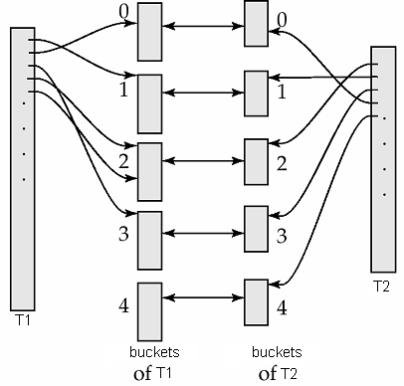
Join-散列连接(hash join)
Create a hash index on the ‘a’-column of T₁ and T₂, respectively, using the same hash function.
Join bucket 0 of T₁ and T₂
…
Join bucket 4 of T₁ and T₂
Do we need to join bucket 1 of T₁ with bucket 2 of T₂?
NO. No join results can be produced from these two buckets.
SELECT * FROM T₁, T₂ WHERE T₁.a = T₂.a

Slide 86
合并两个桶
We distinguish 2 cases depending on whether the smaller relation fits in memory.

Slide 87
合并两个桶(cont.)
Assume that the memory has M pages.
Case 1: The smaller bucket has no more than M – 1 pages.
See the right example.
We apply BNL on the two buckets.
Load the entire bucket of T₂ into memory.
Scan the bucket of T₁ once to produce join results.

Slide 88
合并两个桶(cont.)
Assume that the memory has M pages.
Case 2: The smaller bucket has at least M pages.
Recursively apply hash join.
Hash the data in both buckets into sub-buckets using a different hash function.
Join the corresponding sub-buckets.

Slide 89
Join-散列连接(例子)
T₁ has 45 Pages and T₂ has 450 pages. Our memory has 6 pages.
Hash each table into 5 buckets.
Total Cost with BNL?
45+45*450/9=4095

Slide 90
Cost = (45 + 450) x 2 = 990 I/Os
Hashing reads and writes a relation once.

Slide 91
Join bucket 0 of T1 and T2. Both buckets have more than 5 pages => re-hashing.

Slide 92
Cost = (25 + 250) x 2 = 550 I/Os. Data in the two buckets is read and written once.

Slide 93
Join “sub-bucket 0” of T1 and T2. Both buckets have more than 5 pages => re-hashing.

Slide 94
Hash sub-bucket 0 again. Cost = (6 + 60) x 2 = 132 I/Os.

Slide 95
Join sub-sub-bucket 0 of T1 and T2. Cost = 22 I/Os.

Slide 96
Join sub-sub-bucket 1 of T1 and T2. Cost = 11 I/Os.
Similarly, for sub-sub-buckets 2, 3, 4…

Slide 97
Join sub-bucket 1 of T1 and T2. Cost = 55 I/Os.
Similarly, for sub-buckets 2, 3, 4…

Slide 98
Join bucket 1 of T1 and T2. Cost = 55 I/Os.
Similarly, for buckets 2, 3, 4…

Slide 99
Total cost = 990 + 550 + 132 + 22 + 11 + 11 + 11 + 11 + 55 + 44 + 55 + 55 + 55 + 55 + 55 + 55 = 2167 I/Os < 4095 I/Os

Slide 100
Hash-Join algorithm (Cont.)
The value n and the hash function h is chosen such that each s_{i} should fit in memory.
Typically n is chosen as ⎡b_{s}/M⎤ * f where f is a “fudge factor”, typically around 1.2
The probe relation partitions s_{i} need not fit in memory
Recursive partitioning required if number of partitions n is greater than number of pages M of memory.
instead of partitioning n ways, use M – 1 partitions for s
Further partition the M – 1 partitions using a different hash function
Use same partitioning method on r
Rarely required: e.g., with block size of 4 KB, recursive partitioning not needed for relations of < 1GB with memory size of 2MB, or relations of < 36 GB with memory of 12 MB

Slide 101
Handling of Overflows
Partitioning is said to be skewed if some partitions have significantly more tuples than some others
Hash-table overflow occurs in partition s_{i} if s_{i} does not fit in memory. Reasons could be
Many tuples in s with same value for join attributes
Bad hash function
Overflow resolution can be done in build phase
Partition s_{i} is further partitioned using different hash function.
Partition r_{i} must be similarly partitioned.
Overflow avoidance performs partitioning carefully to avoid overflows during build phase
E.g. partition build relation into many partitions, then combine them
Both approaches fail with large numbers of duplicates
Fallback option: use block nested loops join on overflowed partitions

Slide 102
Cost of Hash-Join
If recursive partitioning is not required: cost of hash join is 3(b_{r} + b_{s}) +4 ∗ n_{h} block transfers + 2( ⎡b_{r} / b_{b}⎤ + ⎡b_{s} / b_{b}⎤) seeks
If recursive partitioning required:
number of passes required for partitioning build relation s to less than M blocks per partition is ⎡log_{⎣M/bb⎦–1}(b_{s}/M)⎤
best to choose the smaller relation as the build relation.
Total cost estimate is: 2(b_{r} + b_{s}) ⎡log_{⎣M/bb⎦–1}(b_{s}/M)⎤ + b_{r} + b_{s} block transfers + 2(⎡b_{r} / b_{b}⎤ + ⎡b_{s} / b_{b}⎤) ⎡log_{⎣M/bb⎦–1}(b_{s}/M) ⎤ seeks
If the entire build input can be kept in main memory no partitioning is required
Cost estimate goes down to b_{r} + b_{s}.

Slide 103
Example of Cost of Hash-Join
instructor teaches
Assume that memory size is 20 blocks
b_{instructor}= 100 and b_{teaches} = 400.
instructor is to be used as build input. Partition it into five partitions, each of size 20 blocks. This partitioning can be done in one pass.
Similarly, partition teaches into five partitions,each of size 80. This is also done in one pass.
Therefore total cost, ignoring cost of writing partially filled blocks:
3(100 + 400) = 1500 block transfers + 2( ⎡100/3⎤ + ⎡400/3⎤) = 336 seeks

Slide 104
Hybrid Hash–Join
Useful when memory sized are relatively large, and the build input is bigger than memory.
Main feature of hybrid hash join:
Keep the first partition of the build relation in memory.
E.g. With memory size of 25 blocks, instructor can be partitioned into five partitions, each of size 20 blocks.
Division of memory:
The first partition occupies 20 blocks of memory
1 block is used for input, and 1 block each for buffering the other 4 partitions.
teaches is similarly partitioned into five partitions each of size 80
the first is used right away for probing, instead of being written out
Cost of 3(80 + 320) + 20 +80 = 1300 block transfers for hybrid hash join, instead of 1500 with plain hash-join.
Hybrid hash-join most useful if M >>

Slide 105
Complex Joins
Join with a conjunctive condition:
r _{θ1∧ θ 2∧... ∧ θ n} s
Either use nested loops/block nested loops, or
Compute the result of one of the simpler joins r _{θi} s
final result comprises those tuples in the intermediate result that satisfy the remaining conditions
θ₁ ∧ . . . ∧ θ_{i –1} ∧ θ_{i +1} ∧ . . . ∧ θ_{n}
Join with a disjunctive condition
r _{θ1 ∨ θ2 ∨... ∨ θn} s
Either use nested loops/block nested loops, or
Compute as the union of the records in individual joins r _{θ i} s:
(r _{θ1} s) ∪ (r _{θ2} s) ∪ . . . ∪ (r _{θn} s)

Slide 106
Other Operations
Duplicate elimination can be implemented via hashing or sorting.
On sorting duplicates will come adjacent to each other, and all but one set of duplicates can be deleted.
Optimization: duplicates can be deleted during run generation as well as at intermediate merge steps in external sort-merge.
Hashing is similar – duplicates will come into the same bucket.
Projection:
perform projection on each tuple
followed by duplicate elimination.

Slide 107
Other Operations : Aggregation
Aggregation can be implemented in a manner similar to duplicate elimination.
Sorting or hashing can be used to bring tuples in the same group together, and then the aggregate functions can be applied on each group.
Optimization: combine tuples in the same group during run generation and intermediate merges, by computing partial aggregate values
For count, min, max, sum: keep aggregate values on tuples found so far in the group.
When combining partial aggregate for count, add up the aggregates
For avg, keep sum and count, and divide sum by count at the end

Slide 108
Other Operations : Set Operations
Set operations (∪, ∩ and ⎯): can either use variant of merge-join after sorting, or variant of hash-join.
E.g., Set operations using hashing:
Partition both relations using the same hash function
Process each partition i as follows.
Using a different hashing function, build an in-memory hash index on r_{i}.
Process s_{i} as follows
r ∪ s:
Add tuples in s_{i} to the hash index if they are not already in it.
At end of s_{i} add the tuples in the hash index to the result.

Slide 109
Other Operations : Set Operations
E.g., Set operations using hashing:
as before partition r and s,
as before, process each partition i as follows
build a hash index on r_{i}
Process s_{i} as follows
r ∩ s:
output tuples in s_{i} to the result if they are already there in the hash index
r – s:
for each tuple in s_{i}, if it is there in the hash index, delete it from the index.
At end of s_{i} add remaining tuples in the hash index to the result.
Notes:
109

Slide 110
Other Operations : Outer Join
Outer join can be computed either as
A join followed by addition of null-padded non-participating tuples.
by modifying the join algorithms.
Modifying merge join to compute r s
In r s, non participating tuples are those in r – Π_{R}(r s)
Modify merge-join to compute r s:
During merging, for every tuple t_{r} from r that do not match any tuple in s, output t_{r} padded with nulls.
Right outer-join and full outer-join can be computed similarly.

Slide 111
Other Operations : Outer Join
Modifying hash join to compute r s
If r is probe relation, output non-matching r tuples padded with nulls
If r is build relation, when probing keep track of which r tuples matched s tuples. At end of s_{i} output non-matched r tuples padded with nulls
Notes:
111

Slide 112
Evaluation of Expressions
So far: we have seen algorithms for individual operations
Alternatives for evaluating an entire expression tree
Materialization: generate results of an expression whose inputs are relations or are already computed, materialize (store) it on disk. Repeat.
Pipelining: pass on tuples to parent operations even as an operation is being executed
We study above alternatives in more detail

Slide 113
Materialization
Materialized evaluation: evaluate one operation at a time, starting at the lowest-level. Use intermediate results materialized into temporary relations to evaluate next-level operations.
E.g., in figure below, compute and store then compute the store its join with instructor, and finally compute the projection on name.

Slide 114
Materialization (Cont.)
Materialized evaluation is always applicable
Cost of writing results to disk and reading them back can be quite high
Our cost formulas for operations ignore cost of writing results to disk, so
Overall cost = Sum of costs of individual operations + cost of writing intermediate results to disk
Double buffering: use two output buffers for each operation, when one is full write it to disk while the other is getting filled
Allows overlap of disk writes with computation and reduces execution time

Slide 115
Pipelining
Pipelined evaluation : evaluate several operations simultaneously, passing the results of one operation on to the next.
E.g., in previous expression tree, don’t store result of
instead, pass tuples directly to the join.. Similarly, don’t store result of join, pass tuples directly to projection.
Much cheaper than materialization: no need to store a temporary relation to disk.
Pipelining may not always be possible – e.g., sort, hash-join.
For pipelining to be effective, use evaluation algorithms that generate output tuples even as tuples are received for inputs to the operation.
Pipelines can be executed in two ways: demand driven and producer driven

Slide 116
Pipelining (Cont.)
In demand driven or lazy evaluation
system repeatedly requests next tuple from top level operation
Each operation requests next tuple from children operations as required, in order to output its next tuple
In between calls, operation has to maintain “state” so it knows what to return next
In producer-driven or eager pipelining
Operators produce tuples eagerly and pass them up to their parents
Buffer maintained between operators, child puts tuples in buffer, parent removes tuples from buffer
if buffer is full, child waits till there is space in the buffer, and then generates more tuples
System schedules operations that have space in output buffer and can process more input tuples
Alternative name: pull and push models of pipelining

Slide 117
Pipelining (Cont.)
Implementation of demand-driven pipelining
Each operation is implemented as an iterator implementing the following operations
open()
E.g. file scan: initialize file scan
state: pointer to beginning of file
E.g.merge join: sort relations;
state: pointers to beginning of sorted relations
next()
E.g. for file scan: Output next tuple, and advance and store file pointer
E.g. for merge join: continue with merge from earlier state till next output tuple is found. Save pointers as iterator state.
close()

Slide 118
Evaluation Algorithms for Pipelining
Some algorithms are not able to output results even as they get input tuples
E.g. merge join, or hash join
intermediate results written to disk and then read back
Algorithm variants to generate (at least some) results on the fly, as input tuples are read in
E.g. hybrid hash join generates output tuples even as probe relation tuples in the in-memory partition (partition 0) are read in
Double-pipelined join technique: Hybrid hash join, modified to buffer partition 0 tuples of both relations in-memory, reading them as they become available, and output results of any matches between partition 0 tuples
When a new r₀ tuple is found, match it with existing s₀ tuples, output matches, and save it in r₀
Symmetrically for s₀ tuples

Slide 119
Assignments
12.1
12.2
12.3

Slide 120
End of Chapter

